Slide 1
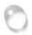
R
EALTIME SIMULATION THEORY
PBD & Related Derivatives

Slide 2
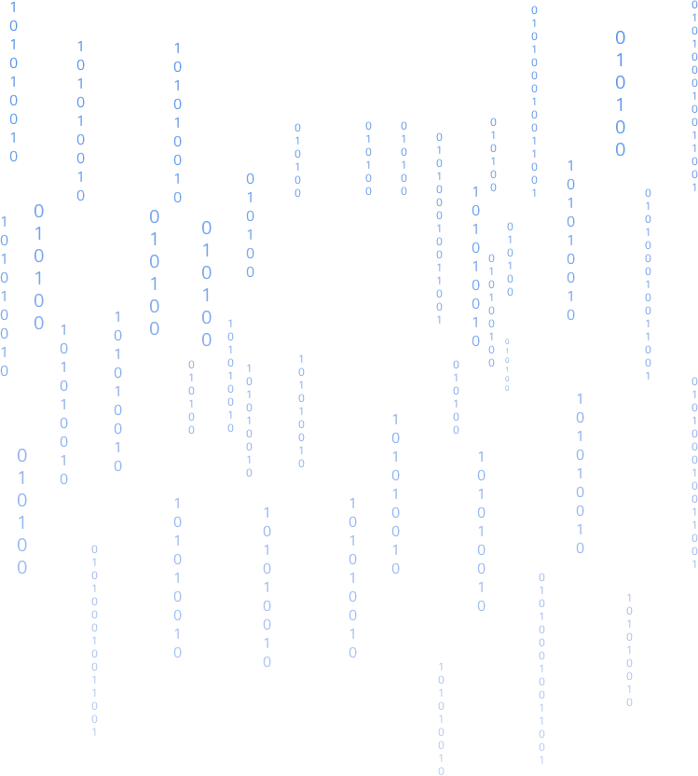


PBA Recap
Linear iteration ($Ax=b$)
$A$ = $\left[\begin{matrix}a_{11} & a_{12} & a_{13} \\ a_{21} & a_{22} & a_{23} \\ a_{31} & a_{32} & a_{33}\end{matrix}\right]$ $x=\left[\begin{matrix}x_{1} \\ x_{2} \\ x_{3}\end{matrix}\right]$ $b=\left[\begin{matrix}b_{1} \\ b_{2} \\ b_{3}\end{matrix}\right]$
Jacobi $\left\{\begin{aligned}x_{1}^{k+1}=\frac{1}{a_{11}}\left(−a_{12}x_{2}^{k}−a_{13}x_{3}^{k}+b_{1}\right) \\ x_{1}^{k+1}=\frac{1}{a_{11}}\left(−a_{12}x_{2}^{k}−a_{13}x_{3}^{k}+b_{1}\right) \\ x_{1}^{k+1}=\frac{1}{a_{11}}\left(−a_{12}x_{2}^{k}−a_{13}x_{3}^{k}+b_{1}\right)\end{aligned}\right.$
Gauss-Seidel $\left\{\begin{aligned}x_{1}^{k+1}=\frac{1}{a_{11}}\left(−a_{12}x_{2}^{k}−a_{13}x_{3}^{k}+b_{1}\right) \\ x_{1}^{k+1}=\frac{1}{a_{11}}\left(−a_{12}x_{2}^{k+1}−a_{13}x_{3}^{k}+b_{1}\right) \\ x_{1}^{k+1}=\frac{1}{a_{11}}\left(−a_{12}x_{2}^{k+1}−a_{13}x_{3}^{k+1}+b_{1}\right)\end{aligned}\right.$
Euler integral
Explicit Euler
$$\vec{v}\left(t_{1}\right)=\vec{v}\left(t_{0}\right)+M^{−1}\vec{F}\left(t_{0}\right)Δt$$
$$x\left(t_{1}\right)=x\left(t_{0}\right)+\vec{v}\left(t_{0}\right)Δt$$
Semi_Implicit Euler
$$\vec{v}\left(t_{1}\right)=\vec{v}\left(t_{0}\right)+M^{−1}\vec{F}\left(t_{0}\right)Δt$$
$$x\left(t_{1}\right)=x\left(t_{0}\right)+\vec{v}\left(t_{1}\right)Δt$$
Implicit Euler
$$\vec{v}\left(t_{1}\right)=\vec{v}\left(t_{0}\right)+M^{−1}\vec{F}\left(t_{1}\right)Δt$$
$$x\left(t_{1}\right)=x\left(t_{0}\right)+\vec{v}\left(t_{1}\right)Δt$$

Slide 3
PBD Intro
Physics simulation is one of the important contents of computer graphics research. In video games, we often see the application of simulation technology, such as real-time simulation of complex physical phenomena (collision, deformation, tearing, explosion, fluid flow, etc.), which presents nearly realistic visual effects and greatly improves the immersive experience of the game world. The realization of "high-realism" physics simulation is of course inseparable from the support of reliable algorithms and powerful computing power.
Different from the traditional PBA (Physically based animation), PBD (Position based dynamics) is not a physics-based simulation in the traditional sense, but it can provide visually credible and computationally efficient simulation effects. Therefore, it is often used in scenarios with high realtime requirements, such as video games.

Slide 4
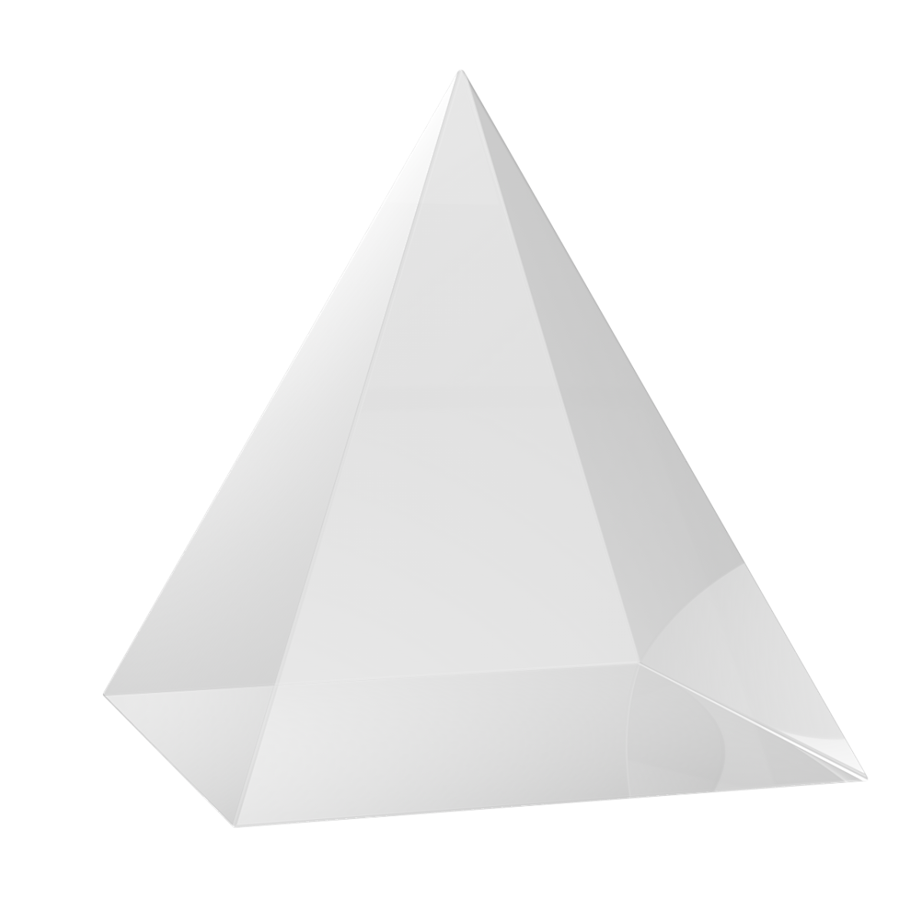
PBD vs PBA
PBD is a physical simulation method published by Müller et al. in 2007. The position-based model omits the multiple integrations from acceleration to velocity and from velocity to position, and directly processes the position. By constructing "constraints" and then projecting the constraints (constraint projection) to obtain the latest position of the object, and using the position to update the velocity, the overshooting problem is cleverly eliminated. However, solving the overshoot problem does not mean that true numerical stability has been achieved, because numerical stability requires that the error of the current time step tends to 0 with iteration, while the PBD algorithm does not guarantee that the error will tend to 0. It can only ensure that the error of the next step is within a smaller range. Similarly, since the "constraint" itself is an approximation of the real physical force, there is always a certain degree of deviation in the calculated position. In short, PBD is not a physics-based simulation in the traditional sense. Its simulation effect is not "completely real", but "looks very real".

Slide 5
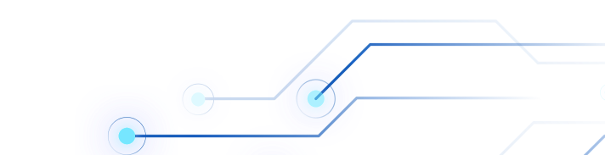

PBD Pipeline
(1) forall vertices i
(2) initialize $x_{i}$ =${ x}_{i}^{0}$, $v_{i}$ =${ v}_{i}^{0}$, $w_{i}$ = 1 / $m_{i}$
(3) endfor
(4) loop
forall vertices i do $v_{i}$ ← $v_{i}$ + ∆t $w_{i} f_{ext}$(xi)
dampVelocities($v_{1}$,..., $v_{N}$)
(7) forall vertices i do $p_{i}$ ← $x_{i}$ +∆t $v_{i}$
(8) forall vertices i do generateCollisionConstraints($x_{i}$ → $p_{i}$)
(9) loop solverIterations times
(10) projectConstraints($C_{1}$,..., $C_{M+M_{coll}}$, $p_{1}$,..., $p_{N}$)
(11) endloop
(12) forall vertices i
(13) $v_{i}$ ← ($p_{i}$ − $x_{i}$) /∆t
(14) $x_{i}$ ← $p_{i}$
(15) endfor
(16) velocityUpdate($v_{1}$,..., $v_{N}$)
(17) endloop

Slide 6
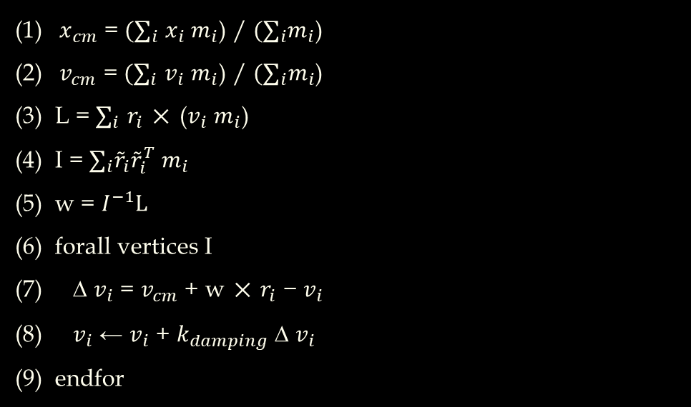
Damping
(1) ${ x}_{cm}$ = ${(∑}_{i}$ $x_{i}$ $m_{i}$) / ${(∑}_{i}m_{i}$)
(2) ${ v}_{cm}$ = ${(∑}_{i}$ $v_{i}$ $m_{i}$) / ${(∑}_{i}m_{i}$)
L = $∑_{i}$ $r_{i}$ × ($v_{i}$ $m_{i}$)
I = $∑_{i}{\tilde{r}}_{i}{\tilde{r}}_{i}^{T}$ $m_{i}$
w = $I^{−1}L$
forall vertices I
∆ $v_{i}$ = $v_{cm}$ + w × $r_{i}$ − $v_{i}$
$v_{i}$ ← $v_{i}$ + $k_{damping}$∆ $v_{i}$
endfor

Slide 7



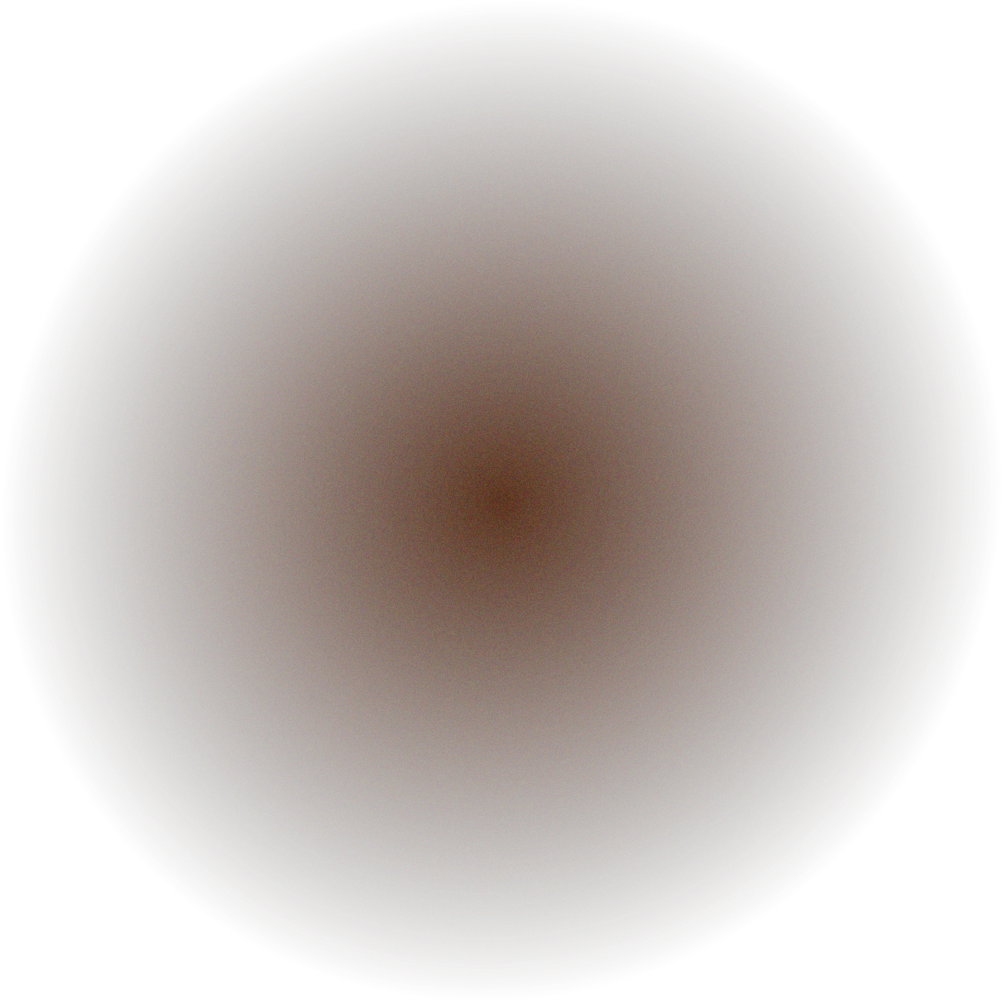

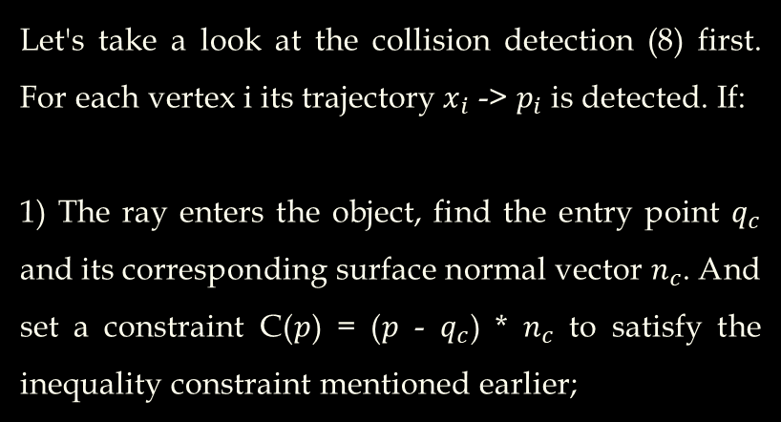
Collision
2) The ray is completely inside the object, then find the point $q_{s}$on the object plane that is closest to the point $p_{i}$and calculate its normal vector $n_{c}$. Set the constraint C($p$) = ($p$ - $q_{c}$) * $n_{c}$ to also satisfy the inequality constraint.
Then this step is completed before the solution loop (9-11), which is more efficient, but it also means that some collision calculations may be missed.
Let's take a look at the collision detection (8) first. For each vertex i its trajectory $x_{i}$ -> $p_{i}$ is detected. If:
1) The ray enters the object, find the entry point $q_{c}$ and its corresponding surface normal vector $n_{c}$. And set a constraint C($p$) = ($p$ - $q_{c}$) * $n_{c}$ to satisfy the inequality constraint mentioned earlier;

Slide 8


Constraint Projection
First, only consider the internal constraints. All points should satisfy the conservation of momentum and angular momentum, that is C($p$ + ∆$p$) = 0. The first-order Taylor expansion of this formula gives: C($p$+ ∆$p$) ≈ C($p$) + $∇pC\left(p\right)∗∆p$ = 0
And, let‘s make it clear that the constraint should be independent of the rigid body transformation (rotation and translation), that is, the gradient $∇pC\left(p\right)$ is orthogonal to the rigid body transformation. Then the interesting point is here. Obviously, when the direction $∆p$ of is consistent with $∇pC\left(p\right)$its internal momentum is naturally conserved. So let: $∆p$ = $λ$ $M^{−1}∇pC\left(p\right)$ = $λ$W$∇pC\left(p\right)$ ($M$ = $diag$($m_{0},…,m_{N−1}$), $W$ = $diag$($w_{0},$…,$w_{N−1}$))

Slide 9
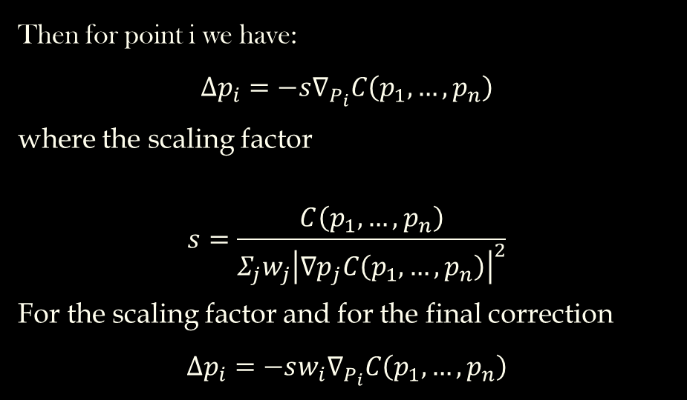
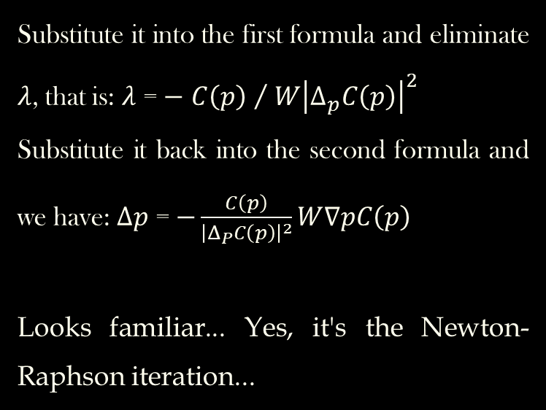
Constraint Projection
Substitute it into the first formula and eliminate $λ$, that is: $λ$ = $−$ ${C\left(p\right) }/{ {W\left|Δ_{p}C\left(p\right)\right|}^{2}}$
Substitute it back into the second formula and we have: $∆p$ = $−\frac{C\left(p\right)}{{\left|Δ_{P}C\left(p\right)\right|}^{2}}W∇pC\left(p\right)$
Looks familiar... Yes, it's the Newton-Raphson iteration...
Then for point i we have:
$$Δp_{i}=−s∇_{P_{i}}C\left(p_{1},…,p_{n}\right)$$
where the scaling factor
$$s=\frac{C\left(p_{1},…,p_{n}\right)}{Σ_{j}{w_{j}\left|∇p_{j}C\left(p_{1},…,p_{n}\right)\right|}^{2}}$$
For the scaling factor and for the final correction
$$Δp_{i}=−s{w_{i}∇}_{P_{i}}C\left(p_{1},…,p_{n}\right)$$

Slide 10
Advantages & Disadvantages
Stable (Explicit)
Quick (Implicit)
Not that physical
The physical property (stiffness…) only depends on the time steps and iterations.
Over 1k vertices will cause simulation time burst

Slide 11
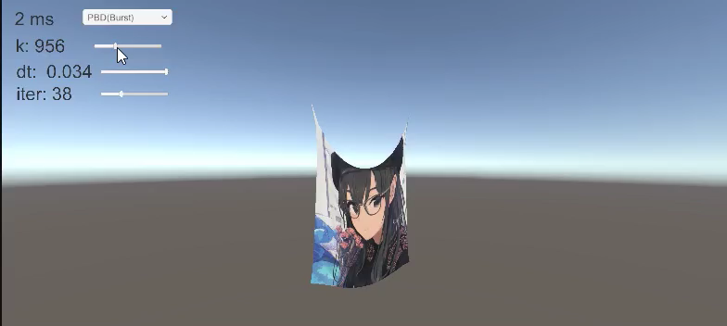
Demo

Slide 12
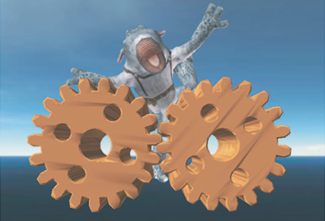
2007
Initialize
Begin Loop
Free Update
Handle Collision
Handle Constrains
Update Velocity
End Loop
PBD (Position Based Dynamics)
[PhysX, Nvidia FleX]

Slide 13
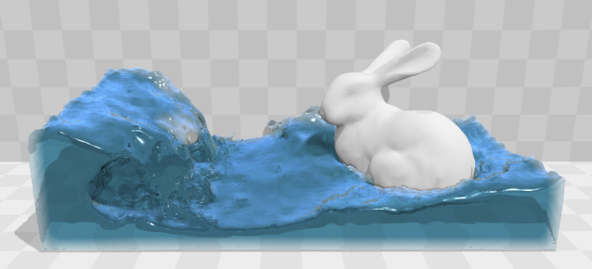
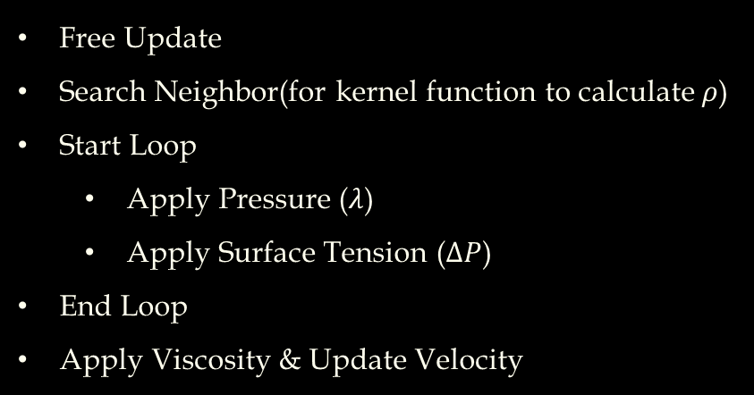
2013
Free Update
Search Neighbor(for kernel function to calculate $ρ$)
Start Loop
Apply Pressure ($λ$)
Apply Surface Tension ($∆P$)
End Loop
Apply Viscosity & Update Velocity
PBF (Positon Based Fluid)
Use PBD to optimization SPH(Smoothed Particle Hydrodynamics))

Slide 14
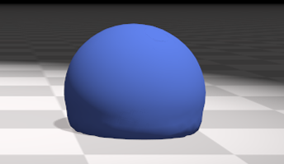
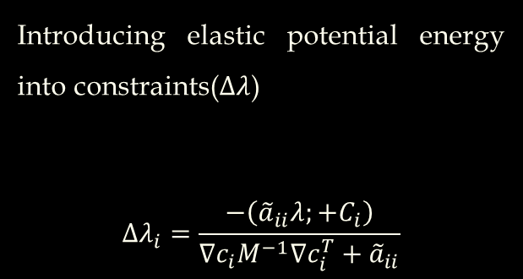
2016
Introducing elastic potential energy into constraints($Δλ$)
$$Δλ_{i}=\frac{−\left({\tilde{a}}_{ii}λ;+C_{i}\right)}{∇c_{i}M^{−1}∇c_{i}^{T}+{\tilde{a}}_{ii}}$$
XPBD (PBD with Compliant Constrained)
[UE Chaos]

Slide 15
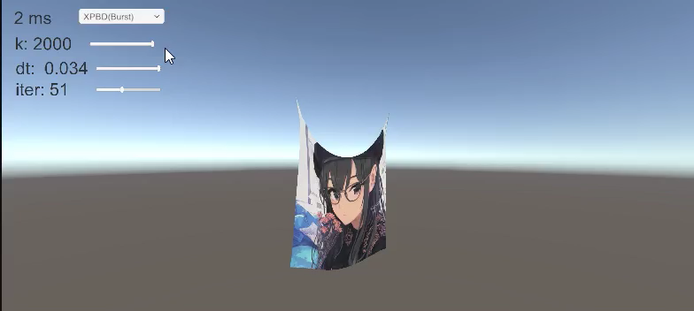
XPBD Demo

Slide 16
Comparation
35 * 35 Mesh, 2000 k, 32 iterations, 64 threads, GTX 1650 Laptap
Project available: https://github.com/Ayinzhang/PBA-and-PBD-Cloth
(Also compare with C++ and thread lib)
 | Unity Main Thread | Unity Job + Burst
Semi-Explicit Euler | 36.9 ms | 1.6 ms
Implicit Euler | N/A | N/A
PBD | 70.9 ms | 2.1 ms
XPBD | 52.2 ms | 2.2 ms

Slide 17
Thanks for your time

